Slide 1
CSE 111 Fall 2024 Checkpoint 1
Video Game Database
By: Ali Adham and Bilal Adham

Slide 2
Synopsis
Stores information about video games and other related entities
Users query entities and relationships for
Stores multi-platform games as distinct games
The same game released on PC and Xbox would be stored as two distinct games
Games released on different platforms tend to have different publishers or developers

Slide 3
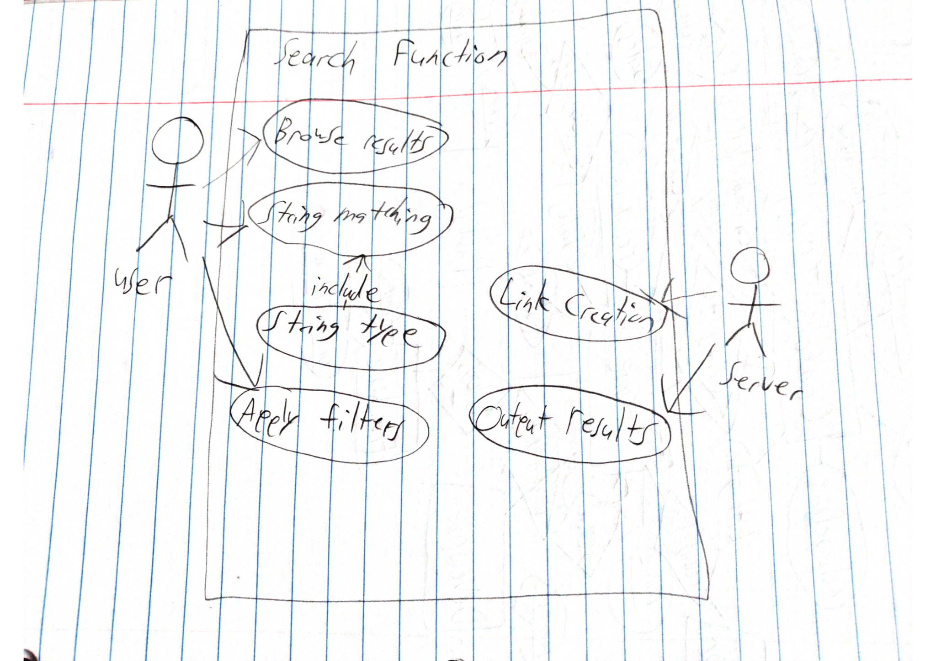
UML Use Case Diagram
The main use case is for users to search for games or other video game related entities (developers, publishers, platforms). A user uses the application to search for their desired info through the use of filters, ranges, and string matching.

Slide 4
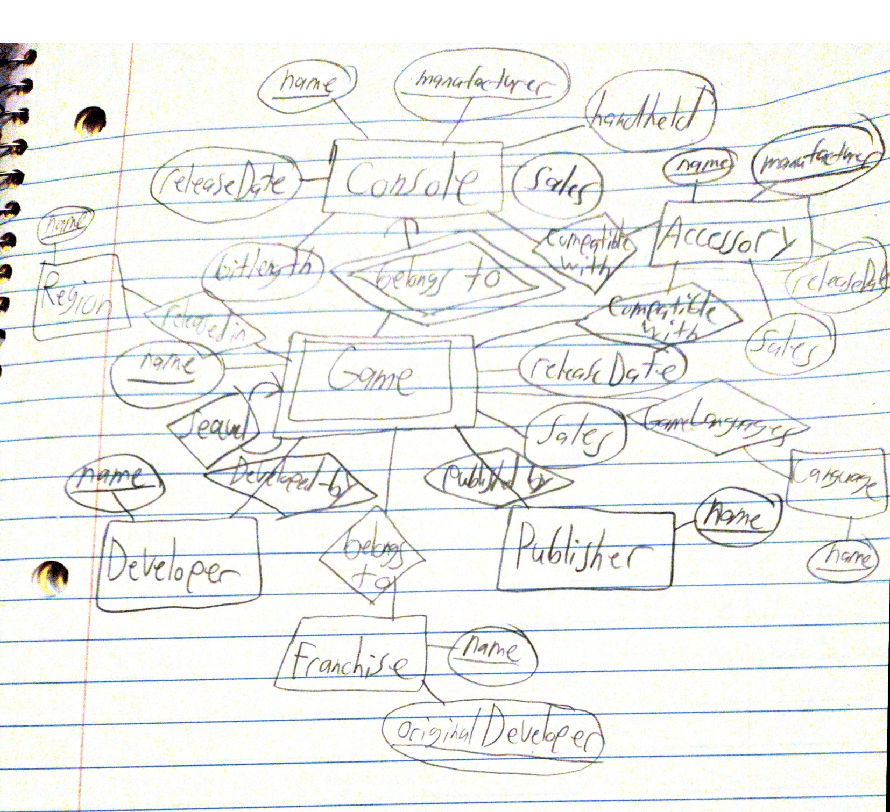
E/R Diagram

Slide 5
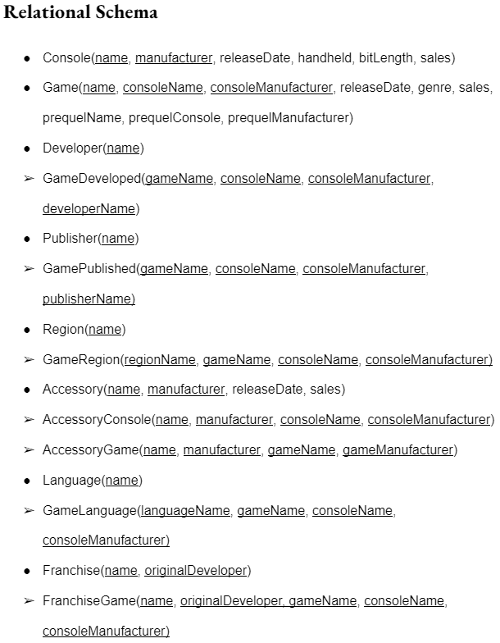
Relational Schema

